Slide 1
Cyclistic monthly members versus casual riders
An analysis of ride length and rides on different days of the week

Slide 2
Introduction

Slide 3

Case study based on sample data
Analysis should show different relationships between casual riders and monthly members
Analysis to be used by by the Marketing and Exec teams to make future campaign decisions

Slide 4
Data and Data Collection

Slide 5


Data was provided by Coursera and is available in the GitHub repository for this project:
Cyclistic Customer Analysis Project Page

Slide 6
Data Cleaning and Preparation

Slide 7

The analysis and image generation was done using the programming language R.
The data was fairly dirty, and required precise and extensive evaluation and manipulation.

Slide 8
Data Analysis

Slide 9
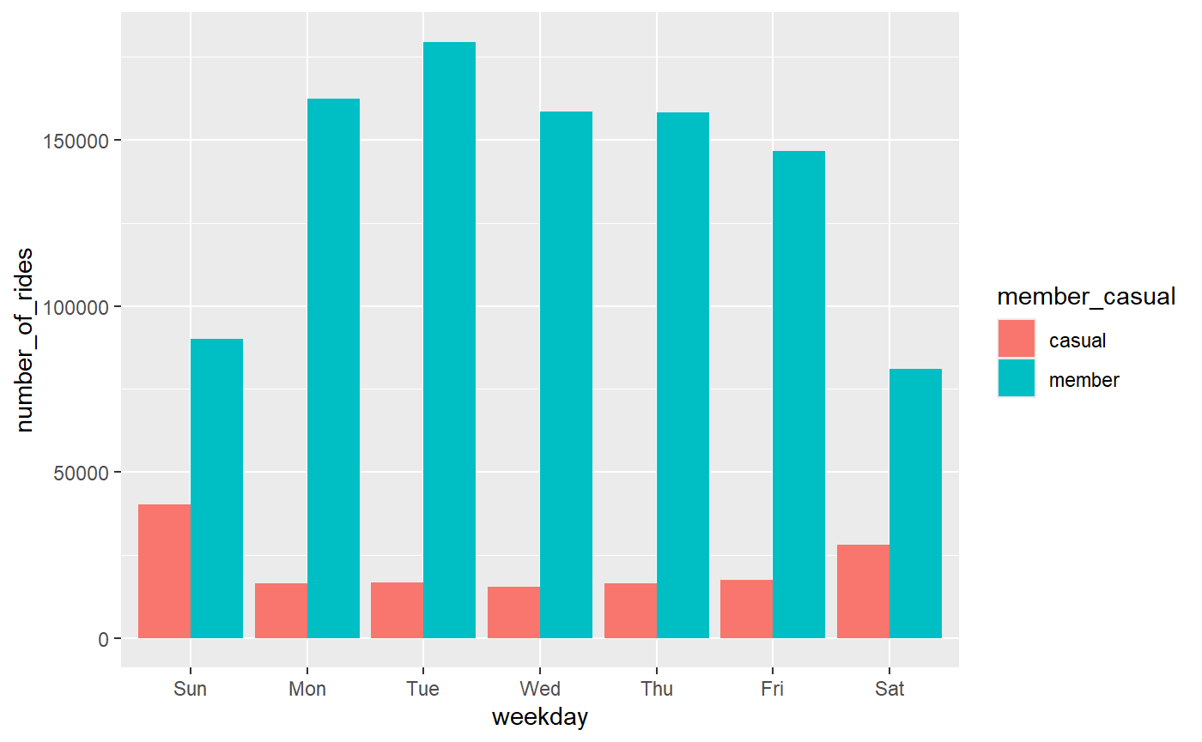
A comparison of casual riders and monthly members total number of rides across the individual weekdays.

Slide 10
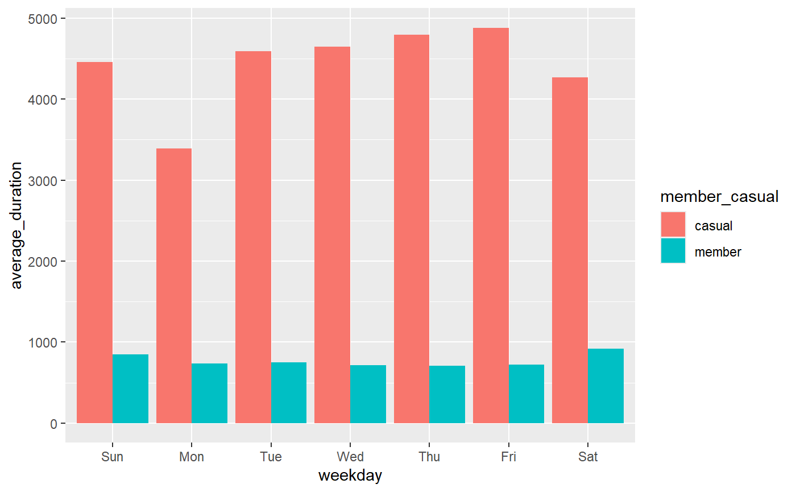
A comparison of casual riders and monthly members’ average trip time across the individual weekdays.

Slide 11
Findings

Slide 12
Four observations
Cyclistic has far more monthly members than casual customers, at a factor of 2x or 3x.
Monthly members take more rides more on the weekdays, and less on the weekend.
Casual riders take less riders on the weekdays, and more on the weekend.
Casual trip times are long than monthly members by a factor of roughly 4x.

Slide 13
For additional information, please visit https://github.com/twofistededitor/Cyclistic-Customer-Analysis.

